Slide 1
Privacy by Design
Building Data Privacy and Protection in, Versus Bolting in on Later
1:15pm – 1:55pm, 1E 12/13, Strata NYC Sept 12, 2018

Slide 2
Speaker Bio
Les has over twenty years’ experience in information security. He has held the position of Chief Information Security Officer (CISO) for a credit card company and ILC bank, founded a computer training and IT outsourcing company in Europe, directed the security and network technology practice for Cambridge Technology Partners across Europe and helped several security technology firms develop their initial product strategy. Les founded and managed Teradata’s Information Security, Data Privacy and Regulatory Compliance Center of Excellence, was Chief Security Strategist at Protegrity and Vice President of Security Strategy at BlueTalon.
Cell (617) 501-7144 Les.McMonagle@Gmail.com

Slide 3
Agenda
What is Privacy by Design
Privacy and Compliance Challenges
Data Protection – versus – Data Access Control
De-Identification – Anonymization – Pseudonymization
Data Privacy Principles
Data Privacy Checklist and Action Items
Q & A

Slide 4
What is Privacy by Design ?
A proactive, risk based approach to application development and systems engineering which considers data privacy throughout the entire requirements gathering, design, development, implementation and operationalization process.

Slide 5
Data Privacy and Regulatory Compliance Challenges
Globalization, Outsourcing, Cloud Computing
Blurring of Network Boundaries
International, National, State and Local Government Data Privacy Regulations
Industry Specific Data Privacy and Data Protection Requirements
Corporate Internal Security Policy, Culture and Risk Tolerance
Auditing Compliance

Slide 6
Opposing Forces
Data monetization
Broader access to ever more data
Sheer volume and proliferation of PII, PHI and other NPI
Cost and budgetary constraints
Expanding privacy regulations
Data Security can be a business enabler if done right

Slide 7
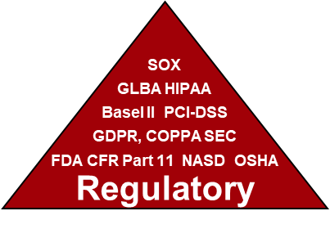
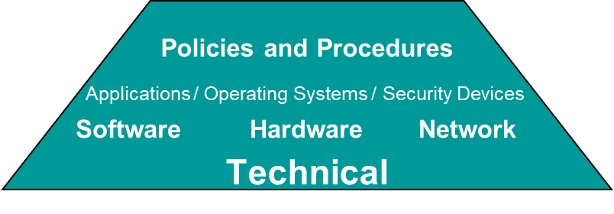
Capture ALL Requirements Up Front

Slide 8
Business
Internal Policies
Data Classification
Company Culture
Appetite for Risk (financial and reputational)
Customers (B2B, B2C)
Business Partners
People, Organization, Process
Start here – Requirements may already be well documented

Slide 9
Technical
Network Security Controls
Hardware Security Controls
OS Security Controls
Application Layer Security Controls
Data Protection (encryption / tokenization) versus Data Access Control (RBAC / ABAC)
Technology used may dictate available controls options

Slide 10
Regulatory
INTERNATIONAL: GDPR – General Data Protection Regulation - Europe
NATIONAL: PIPEDA – Canada, DPA – UK, BDSG – BRD, Privacy Act – Australia
US FEDERAL: HIPAA / HiTech / Omnibus Rule – US
US FEDERAL: COPPA, IRS-1075, ITAR. GLBA. FCRA. ECPA. FERPA - US
US STATE: 201 CMR 17 – MA, Consumer Privacy Act (AB-375) – CA, Ch. 230 – ME
Business may be global but regulations are local

Slide 11
Data Protection: Encryption / Tokenization / Masking / Obfuscation
Encryption
Data is converted to binary Ciphertext using mathematical algorithm. Can be one-way (Hash) or reversible (Symmetric or Asymmetric).
Tokenization
Real data is replaced with randomly generated characters of same data type.
Masking
Stored data unchanged. Masked on presentation only (in Views or Web Pages).
Obfuscation
Data is converted to irreversible values stored as same data type (copy Prod to Dev).
De-Identification or “Anonymization”
Enough data fields are “protected” to sufficiently de-identify or anonymize records
Format Preserving Encryption (FPE or DTP)
Some benefits of both encryption & tokenization at a significant performance cost
!@#$%a^///&*B()..,,,gft_+!@4#$2%p^&*
4472-8302-9115-3562
uYcDoi@sReKajvP.com
jsmith@protegrity.com
XXX - XX - 6294
381 - 58 - 6294
Mark S. Wilson
John W. Smith
Xxx
X
Xxxxxx
Owner
Detroit
MI
248-999-9999
John
W
Smith
Owner
Detroit
MI
248-632-1292
uYcDoiusReKajvP3Kfg
jsmith@protegrity.com

Slide 12
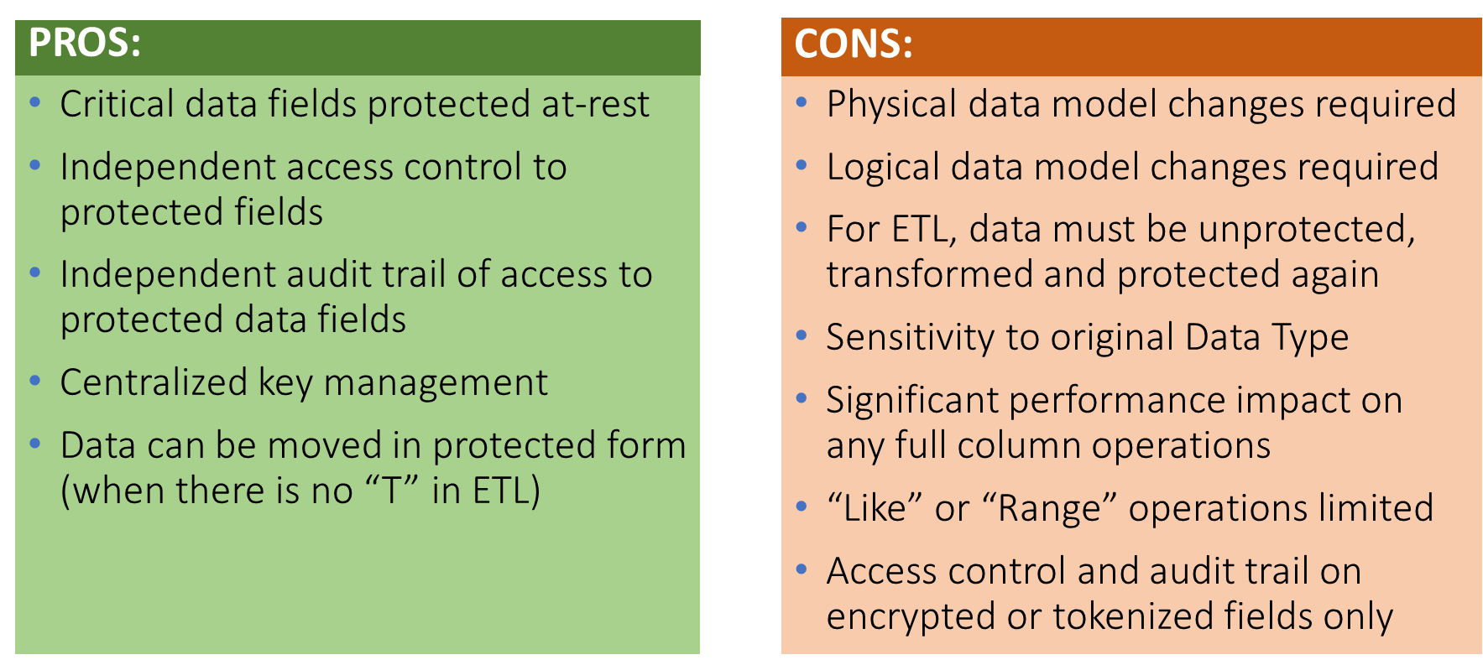
Data Protection: Pros and Cons
Great fit when data protection and access control are only required for a few critical data fields

Slide 13
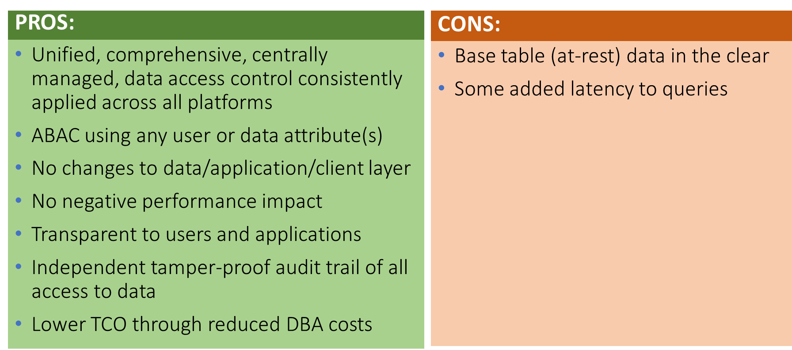
RBAC / ABAC Fine-Grained Data Access Control
Protection / Access Control can be combined gaining the benefits of both, eliminating many costs

Slide 14
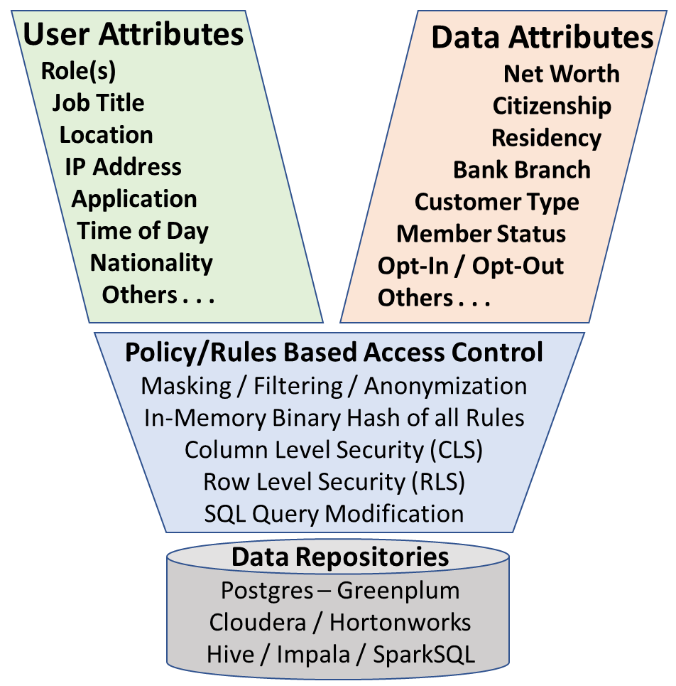
ABAC versus RBAC
LinkedIn Article: 5 Reasons Why RBAC IS Dead

Slide 15
De-Identification - Pseudonymization
“Anonymous” data set if not combined / joined with any other data

Slide 16
De-Identification - Anonymization
Anonymized data no longer deemed PII or PHI under GDPR, HIPAA, COPPA

Slide 17
De-Identification Score
Analysis/Scoring must use defensible, accepted method or process (Expert Determination)
Software tools available that provide consistent scoring of a given data table or data set
Replicability Consistently occur in relation to an individual
(Blood Glucose level vs DOB)
Data Source Availability How prevalent is the data in other locations / sources
(Lab results vs Name, Address)
Distinguishability Extent the data can uniquely identify an individual
(Age/Gender/3 Digit Zip – 0.04% vs DOB/Gender/5 Digit Zip – 50%)
Assess Risk Combined Risk of Identification based on the above 3 characteristics
(Low vs High)

Slide 18
Internationally Accepted Privacy Principles
Accountability – organizations accountable for PII under their control
Notice – of data being collected, policies, changes
Consent – Informed, to data collection (Opt-In), consequences of not consenting
Collection Limitation – only data required for intended purpose
Use Limitation – used only for intended purpose and retained only as long as required
Disclosure – only shared with external parties with permission or when legally required
Access and Correction – data subjects provided access to view and correct their PII
Security and Safeguards – to protect against misuse, loss, unauthorized access
Data Quality – accurate, complete, current PII / PHI
Enforcement – ensure compliance with policy, complaint processing
Openness – published privacy policy
See Reference Slides for more Detailed Descriptions

Slide 19
Data Privacy Checklist and Action Items
Engage InfoSec, Privacy, Legal and Compliance Experts Early and Often
Perform Privacy Impact Assessments (PIA)
Capture, agree on and document all requirements up front
Only keep data you need to reduce scope, liability and exposure footprint
Classification of all sensitive data
De-Identify, Anonymize or Pseudonymize where possible / applicable
Adhere to Internationally Accepted Privacy Principles
Build data security and privacy in from day one to reduce costs and lower risk

Slide 20
Q & A
Reference Slides

Slide 21
Sample Data Privacy Regulations (over 80 countries globally)
GDPR – General Data Protection Regulation - Europe
PIPEDA – Personal Information Protection and Electronic Documents Act = Canada
DPA – Data Protection Act – UK
BDSG – BundesDatenSchutzGesetz – Germany
Privacy Act – Australia
HIPAA – Health Insurance Portability and Accountability Act
COPPA – Children’s On-line Privacy Protection Act
IRS-1075 – Internal Revenue Service
ITAR - International Traffic in Arms Regulations
GLBA – Gramm-Leach-Bliley Act
FCRA – Fair Credit Reporting Act
ECPA – Electronic Communications Privacy Act
FERPA - Family Educational Rights and Privacy Act
PCI-DSS – Payment Card Industry – Data Security Standard
201 CMR 17 – MA, Consumer Privacy Act (AB-375) – CA, Ch. 230 – ME

Slide 22
Sample Product Vendors in Various Categories
Data Protection: Micro Focus (Voltage), Protegrity
ABAC: Axiomatics, BlueTalon
Data Governance / Classification: Colibra, BigID
Data Anonymization: Privitar
Data Obfuscation / Masking: Informatica DDM, Grid Tools
Data Discovery: DataGuise
GRC: https://www.oceg.org/about/what-is-grc/
DCAP: See Gartner DCAP Annual Market Guide for representative vendors

Slide 23
HIPAA Compliance, HITECH, Omnibus Rule, HIPAA 18
Reference Slides

Slide 24
HIPAA 18 - All encrypted/tokenized/obfuscated = Safe Harbor
(A) Names
(B) All geographic subdivisions smaller than a state, including street address, city, county, precinct, zipcode
(C) All elements of dates (except year) for dates that are directly related to an individual, including DOB, etc.
(D) Telephone numbers
(L) Vehicle identifiers, serial numbers, license plate #’s
(E) Fax numbers
(M) Device identifiers and serial numbers
(F) Email addresses
(N) Web Universal Resource Locators (URLs)
(G) Social security numbers
(O) Internet Protocol (IP) addresses
(H) Medical record numbers
(P) Biometric identifiers, including finger and voice prints
(I) Health plan beneficiary numbers
(Q) Full-face photographs and any comparable images
(J) Account numbers
(R) Any other unique identifying #, characteristic, or code
(K) Certificate/license numbers

Slide 25
Safe Harbor versus Expert Determination
Replicability Consistently occur in relation to an individual
(Blood Glucose level vs DOB)
Data Source Availability How prevalent is the data in other locations / sources
(Lab results vs Name, Address)
Distinguishability Extent the data can uniquely identify an individual
(Age/Gender/3 Digit Zip – 0.04% vs DOB/Gender/5 Digit Zip – 50%)
Assess Risk Combined Risk of Identification based on the above 3 characteristics
(Low vs High)
De-identified health information utilizing these methods is no longer PHI, therefore
not protected by the Privacy Rule because it does not fall within the definition of PHI
Refer to: https://www.hhs.gov/hipaa/for-professionals/privacy/special-topics/de-identification

Slide 26
Internationally Accepted Privacy Principles (1/3)
Accountability:
An organization should be held accountable for PII under its control.
Notice:
Notice must be provided to the Data Subject of the purpose for collecting PII.
Data Subject must be notified of applicable policies (Consent, Access, Disclosure).
Notice must be provided of any changes to the applicable privacy policies or the data collected is used for any reason other than the originally stated purpose.
Notice must be provided in clear and conspicuous language.
Notification should be sent at the time of collection or immediately before.
Consent:
Data Subjects must be informed of, and explicitly consent to, the collection, use and disclosure of sensitive information.
The Data Subject must provide informed consent to the collection of PII.
Consent required to use PII for purposes other than those originally stated.
Data Subjects must be made aware of the consequences of denying consent.

Slide 27
Internationally Accepted Privacy Principles (2/3)
Collection Limitation:
Only PII relevant to the identified purpose may be collected.
Information must be collected by fair and lawful means.
Use Limitation:
PII may only be used for the purposes stated at the time of collection.
PII is retained no longer than necessary to complete the stated purpose.
Disclosure:
Consent from the Data Subject is required to disclose information to third parties.
Organizations must ensure that any third parties comply with their privacy policies.
Information may be disclosed if required by law or for health and safety reasons.
Access and Correction:
Data Subjects are able to access, update and correct PII an organization maintains on them.
Data Subjects requesting information must supply sufficient proof of identity.
Requested PII is provided clearly, at reasonable cost and within a reasonable time.
If denied access, Data Subject is informed of reason, options to challenge denial.

Slide 28
Internationally Accepted Privacy Principles (3/3)
Security and Safeguards:
Provide safeguards to prevent loss, misuse, unauthorized access, disclosure, alteration and destruction of PII.
Destroy or permanently obfuscate discarded or expired data.
Data Quality:
Organizations must ensure PII is accurate, complete and up-to-date.
Enforcement:
Implement processes to ensure compliance with the privacy policies.
Include a process for data subjects to file complaints and have them reviewed.
Openness:
Ensure privacy policies are clearly published and publicly available.
Have a means to establish the existence, nature and purpose of use, of PII.

Slide 29
Questions to Ask During PIA / Requirements Gathering
1. Has your company experienced any known significant unauthorized access to sensitive or regulated data in the last two years?
2. Is there any specific compelling event or deadline you need to comply with requiring a decision on data protection method(s) to deploy? Events can include planned internal or external audits, PCI-DSS Compliance Audit, changes to industry specific data privacy regulations or changes to national data privacy laws impacting your firm.
3. What are all of the different environments or data repositories currently hosting sensitive PII or PHI data?
(Oracle, MS-SQL, Teradata, Hadoop, Netezza, Greenplum, DB2 on Mainframe, Cloud applications, file servers.)
4. Is all corporate data classified into specific categories with clear guidance on data protection and data privacy requirements for each (Confidentiality, Integrity, Availability)?
5. Is there a published Data Privacy policy describing why customer data is collected, what it is used for, who has access and how it should be protected at-rest, in-transit and in-use?
6. Is there a formal policy document that defines data privacy, access control and auditing requirements specifically for data in the platform (being discussed)?
7. Is there documented information security policies that govern data collection, data storage, data transmission, data retention and data destruction?
8. Does any involved data repository platform contain Personally Identifiable Information (PII) such as Social Security Numbers (SSN, NI-UK, SIN-Canada, etc.), Protected Health Information (PHI), customer financial records such as bank account details, credit card numbers (PAN) or other Non-Public Information (NPI) or sensitive Intellectual Property (IP)?
9. Is there someone in the company with the official title of Head of Information Security or Chief Information Security Officer (CISO) with responsibility for Data Privacy and Regulatory Compliance involving sensitive or regulated data?
10. What Data-Centric data protection tools or utilities are deployed or are being planned for deployment? Refer to Gartner DCAP market report.
11. Is your company considering the use of all available data protection methods including encryption, tokenization, masking, data obfuscation and/or format preserving encryption?
12. Does your company have assigned Data Owners for all data that are actively involved in setting access policy, authorizing all access to their data and regularly reviewing who has access to their data across relevant platforms or data repositories?
13. Are the Data Owners aware of everyone who has access to their data and where all copies of their data exist if they were asked?
14. Is data contained in the EDW or other environment classified or identified according to a standard Data Classification scheme?

Slide 30
Questions to Ask During PIA / Requirements Gathering
15. Does you company apply the principle of least privilege when granting access to sensitive data?
16. Does your company use Attribute Based Access Control (ABAC) to govern access to regulated data or only Role Based Access Controls (RBAC) within the EDW?
17. Are you aware of all of the regulatory compliance requirements resulting from the types of data hosted by your organization?
18. Have you ever conducted a Risk Assessment or audit of existing systems to determine compliance with company policy, privacy laws and other regulatory compliance requirements?
19. How many users have direct ad hoc query access to sensitive data?
20. How many external users, contractors, offshore developers or business partners have access to the sensitive data?
21. Are shared accounts used for accessing data through any application or in any data repository that do not provide accountability back to the originating end-user?
22. Is there any logging of access to sensitive data?
23. Is there any process in place to monitor or review access log data?
24. Does your company use a formal or recognized Information Security Management System (ISMS) framework such as ISO 2700x as a reference or benchmark for implemented security controls within the various data repositories?
25. Are there any known risks regarding access to sensitive data that are not being adequately managed or mitigated?
26. Is each new source of data imported into the organization evaluated and classified prior to providing broad, unlimited access to the data by System Admins, DBA’s or business users?

Slide 31
Session Abstract
Privacy by Design

Slide 32
Session Abstract – Strata – Privacy by Design
This session will introduce the concept of “Privacy by Design”, what it means, why it is so important and how to implement it within any organization.
Adhering to internationally accepted data privacy principles in every new data analytics initiative ensures compliance with virtually all current government or industry mandated data privacy regulations. Enable the business to extract maximum financial benefit from available data assets without violating the trust between your organization and your customers.
This session will outline how to apply various data protection and data access control technologies (both natively available and third party vendor add-on solutions) to achieve compliance with GDPR, HIPAA and other data privacy or data protection regulations.
Never wait until just before going live in production to think about data privacy and security. Build it in from the beginning to facilitate better regulatory compliance, reduce risk, reduce operating costs, shorten development times, improve customer trust and loyalty and gain more open access to sensitive and regulated data for business benefit, without violating generally accepted privacy principles.

Slide 33
DCAP Solutions
Reference information

Slide 34
Factors to consider in selecting and comparing protection methods
Algorithm  | Encryption (AES / TDES) | Vaultless Tokenization | Vault-based Tokenization | Format Preserving Encryption | Masking / Obfuscation
Properties 
Strength | Strong | Strong | Strong | Strong | Strong - Medium
Where Used | Production | Production / Non-Production | Production / Non-Production | Production / Non-Production | Non-Production
Performance | Fastest | Fast | Slowest | Medium | Medium – N/A
Transparency | Poor | High | High | High | High
Reversibility | Reversible | Reversible | Reversible | Reversible | Not Reversible
Standards Based | NIST, FIPS & Others | None | None | NIST | None
Usability with Analytics | Medium | High | Medium | High | Medium
Deployment Choices | Cluster or In-Process | Cluster or In-Process | Cluster | Cluster or In-Process | N/A
Applicability for PCI DSS | Medium | Highest | High | Medium | Not Usable
Applicability for PII | High | Highest | Not Usable | High | Low
Applicability for PHI | High | Highest | Not Usable | High | Low

Slide 35
To Encrypt or Tokenize - This is the Question
Tokenization
Encryption
SSN
PIN, CID, CV2 Password
Increasing Data Sensitivity
CC-PAN
X-Ray Cat Scan HIV-Pos* Diagnosis report
Medical Records
Patient ID
Bank Account
Customer ID
Last Name
DOB
First Name
Address
Large
More
More
Less
Field Size relative to width of lookup table
Structured
Logic in portions of the data element
Percent of Access Requiring Clear Text
Small
Less
Less
More

Slide 36
What to look for in a good DCAP Solution
A single solution that works across all core platforms
Scalable, centralized enterprise class solution
Segregation of duties between DBA and Security Admin
Data layer / Data-Centric solution
Tamper-proof audit trail
Transparent (as possible) to authorized end-users
High Availability (HA)
Optional in-database vs ex-database encryption/tokenization

Slide 37
Other “Nice to Have” Features
Flexible protection options (Encrypt, Tokenize, DTP/FPE, Masking)
Broadest possible support for a range of data types
Built in DR, Dual Active, Key and system recovery capability
Minimal performance impact to applications/end users
Optimized operations to minimize CPU utilization
Proven Implementation methodology
PCI-DSS compliant solution (meeting all relevant requirements)
Deep partnership with Teradata and other database providers
Minimal impact on system upgrades
Maintain consistent referential integrity and indexing capability
Low Total Cost of Ownership (TCO)

